Slide 1
Proactive Remediations and Azure Functions better together

Slide 2


Jan Ketil Skanke
Principal Cloud Architect
@JankeSkanke
MVP Enterprise Mobility
Nickolaj Andersen
Senior Architect
@NickolajA
MVP Enterprise Mobility

Slide 3
Proactive Remediations
Short introduction

Slide 4
What is Proactive Remediations
Proactive Remediations in Endpoint Analytics allows us to:
Automatically detect and remediate common issues
Possible to trigger once or on a schedule
Measure desired state configurations on endpoints
Assess and notify end-users
Essentially reduce the number of potential helpdesk calls
Similar to Configuration Items / Configuration Baselines
Proactive Remediations are composed of two script packages:
Detection Script (detect.ps1)
Remediation Script (remediation.ps1)

Slide 5
What are the prerequisites
Devices must be enrolled into Endpoint Analytics
Either as Intune managed or co-managed
Devices must be Azure AD joined or hybrid Azure AD joined and meet one of the following conditions:
A Windows 10 Enterprise, “Professional” or Education device managed by Intune
A co-managed device running Windows 10, version 1903 or later
Licensing requirements:
Windows 10 Enterprise E3 or E5
Windows 10 Education A3 or A5
Windows Virtual Desktop Access E3 or E5
Notes:
Intune enrolled or co-managed devices running Windows 10 Pro, Windows 10 Pro Education, Windows 10 Enterprise, or Windows 10 Education. Windows 10 Home isn't supported.
Startup performance insights are only available for devices running version 1903 or later of Windows 10 Enterprise, Education, or Pro. Windows 10 long-term servicing channel (LTSC) isn't supported.
Windows 10 Pro versions 1903 and 1909 require KB4577062.
Windows 10 Pro versions 2004 and 20H2 require KB4577063.
Windows 10 devices must be Azure AD joined or hybrid Azure AD joined.
Workplace joined or Azure AD registered devices aren't supported.
The Connected User Experiences and Telemetry service on the device is running

Slide 6
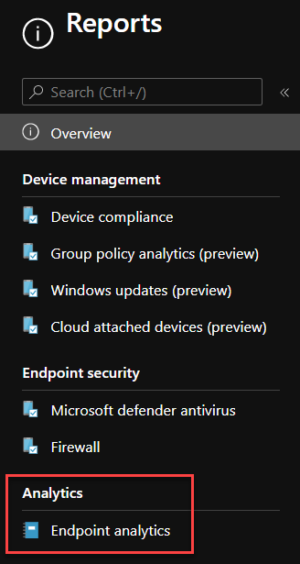
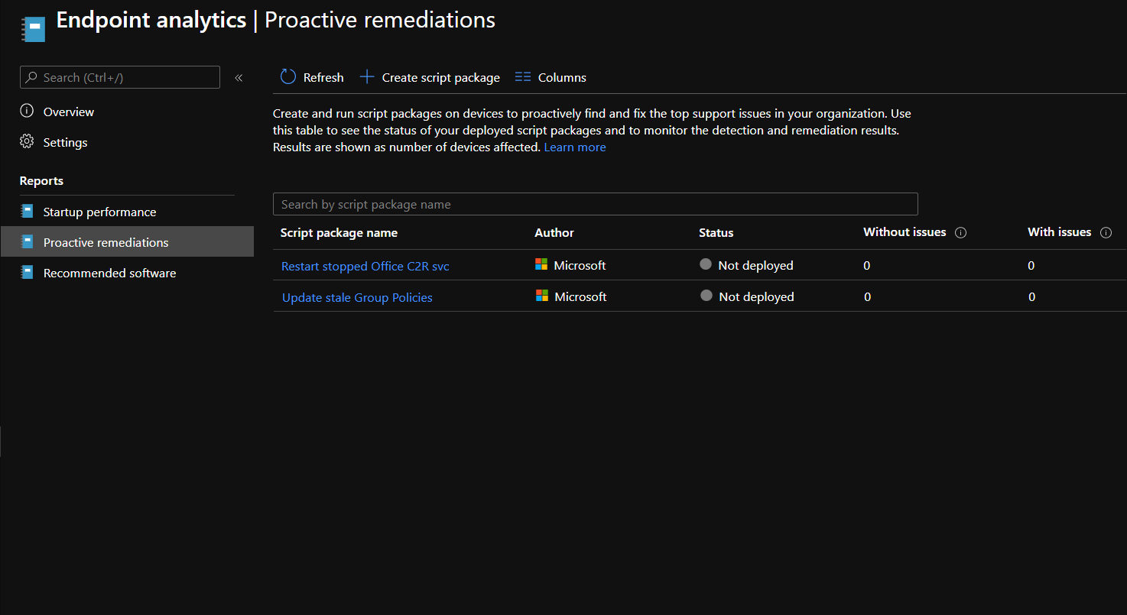
Where to find Proactive Remediations
Client-side details of scripts:
C:\Windows\IMECache\HealthScripts
NTFS permissions configured for system context only

Slide 7
Proactive Remediations
For what and how we use the feature

Slide 8
Common use cases
Extended reporting capabilities:
BitLocker encryption method
Battery health
End user notifications:
Notify user when last reboot was more than X days ago
Notify user when black listen application X was installed
Registry settings enforcement:
Make sure registry key and/or value X is present
Local account management
Custom inventory
And much more…
Notes:
Intune enrolled or co-managed devices running Windows 10 Pro, Windows 10 Pro Education, Windows 10 Enterprise, or Windows 10 Education. Windows 10 Home isn't supported.
Startup performance insights are only available for devices running version 1903 or later of Windows 10 Enterprise, Education, or Pro. Windows 10 long-term servicing channel (LTSC) isn't supported.
Windows 10 Pro versions 1903 and 1909 require KB4577062.
Windows 10 Pro versions 2004 and 20H2 require KB4577063.
Windows 10 devices must be Azure AD joined or hybrid Azure AD joined.
Workplace joined or Azure AD registered devices aren't supported.
The Connected User Experiences and Telemetry service on the device is running

Slide 9
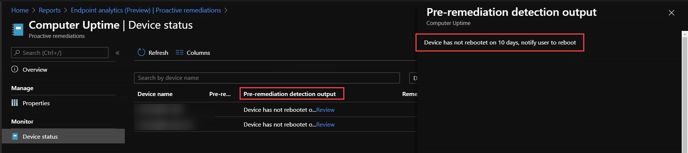
Client-side reporting – Is this really enough?
Proactive Remediations provide basic detection output
Usually enough for most scenarios, but not all
When basic detection output doesn’t fit for reporting needs:
Limited to only last shown output, maximum output size 2048 characters
Missing history of log data
Solution: Use Proactive Remediation with Log Analytics
Notes:
Intune enrolled or co-managed devices running Windows 10 Pro, Windows 10 Pro Education, Windows 10 Enterprise, or Windows 10 Education. Windows 10 Home isn't supported.
Startup performance insights are only available for devices running version 1903 or later of Windows 10 Enterprise, Education, or Pro. Windows 10 long-term servicing channel (LTSC) isn't supported.
Windows 10 Pro versions 1903 and 1909 require KB4577062.
Windows 10 Pro versions 2004 and 20H2 require KB4577063.
Windows 10 devices must be Azure AD joined or hybrid Azure AD joined.
Workplace joined or Azure AD registered devices aren't supported.
The Connected User Experiences and Telemetry service on the device is running

Slide 10
Demo
Proactive Remediations and Log Analytics
Notes:
Demo - PR script that sends data logs to Log Analytics

Slide 11
Be cautios when using cloud services
Retrieval of any data residing in a cloud service requires authentication
For instance, to retrieve primary user data, or check if device is compliant etc.
Store sensitive data strings in Proactive Remediation script files
Sensitive data strings could be similar but not limited to:
Primary keys for Log Analytics workspaces
App registrations client secrets
Storage account connection strings
Should we attempt to remove script upon successful execution?
Keep in mind that script block execution could be logged to the event log

Slide 12
What’s a better option?
Send your logging details to an Azure Function App with HTTP trigger
Function App relays the log data to Log Analytics workspace
…
Proactive Remediation
Azure Function App
Log Analytics workspace
Notes:
Intune enrolled or co-managed devices running Windows 10 Pro, Windows 10 Pro Education, Windows 10 Enterprise, or Windows 10 Education. Windows 10 Home isn't supported.
Startup performance insights are only available for devices running version 1903 or later of Windows 10 Enterprise, Education, or Pro. Windows 10 long-term servicing channel (LTSC) isn't supported.
Windows 10 Pro versions 1903 and 1909 require KB4577062.
Windows 10 Pro versions 2004 and 20H2 require KB4577063.
Windows 10 devices must be Azure AD joined or hybrid Azure AD joined.
Workplace joined or Azure AD registered devices aren't supported.
The Connected User Experiences and Telemetry service on the device is running

Slide 13
Demo
Better Proactive Remediations and Log Analytics
Notes:
Demo - PR script that sends data logs to Log Analytics through Function App

Slide 14
Function App and security
Function Apps can have various authentication and authorization options
Azure AD integrated authentication (delegated or client secret / cert auth flows)
Function or Admin Keys authorization
Anonymous authorization
When building automated solutions, how to deal with security?
Azure AD integrated authentication should not be used
Delegated authentication flow can’t be automated and requires human interaction
Client secret / certificate authentication flows either require sensitive data embedded within script block or a specific certificate locally available on all devices
Function or Admin keys for authorization are also sensitive data
Client certificate from PKI is a good option, but complex and requires additional infrastructure
What should I use then?
Notes:
Intune enrolled or co-managed devices running Windows 10 Pro, Windows 10 Pro Education, Windows 10 Enterprise, or Windows 10 Education. Windows 10 Home isn't supported.
Startup performance insights are only available for devices running version 1903 or later of Windows 10 Enterprise, Education, or Pro. Windows 10 long-term servicing channel (LTSC) isn't supported.
Windows 10 Pro versions 1903 and 1909 require KB4577062.
Windows 10 Pro versions 2004 and 20H2 require KB4577063.
Windows 10 devices must be Azure AD joined or hybrid Azure AD joined.
Workplace joined or Azure AD registered devices aren't supported.
The Connected User Experiences and Telemetry service on the device is running

Slide 15
What’s probably the best option?
Combine Function App Function Key authorization with:
Built-in code with Azure AD device registration certificate validation, or
Built-in code with Azure AD device validation
… Function App with:
Device auth (Nickolaj)
Tenant validation (Jan)
Notes:
Intune enrolled or co-managed devices running Windows 10 Pro, Windows 10 Pro Education, Windows 10 Enterprise, or Windows 10 Education. Windows 10 Home isn't supported.
Startup performance insights are only available for devices running version 1903 or later of Windows 10 Enterprise, Education, or Pro. Windows 10 long-term servicing channel (LTSC) isn't supported.
Windows 10 Pro versions 1903 and 1909 require KB4577062.
Windows 10 Pro versions 2004 and 20H2 require KB4577063.
Windows 10 devices must be Azure AD joined or hybrid Azure AD joined.
Workplace joined or Azure AD registered devices aren't supported.
The Connected User Experiences and Telemetry service on the device is running

Slide 16
Azure AD device registration certificate validation
… Lite visio, beskrivning och github modules
Client-side needs to run elevated to access private key
Notes:
Intune enrolled or co-managed devices running Windows 10 Pro, Windows 10 Pro Education, Windows 10 Enterprise, or Windows 10 Education. Windows 10 Home isn't supported.
Startup performance insights are only available for devices running version 1903 or later of Windows 10 Enterprise, Education, or Pro. Windows 10 long-term servicing channel (LTSC) isn't supported.
Windows 10 Pro versions 1903 and 1909 require KB4577062.
Windows 10 Pro versions 2004 and 20H2 require KB4577063.
Windows 10 devices must be Azure AD joined or hybrid Azure AD joined.
Workplace joined or Azure AD registered devices aren't supported.
The Connected User Experiences and Telemetry service on the device is running

Slide 17
Azure AD device validation
… Lite visio och beskrivning
Notes:
Intune enrolled or co-managed devices running Windows 10 Pro, Windows 10 Pro Education, Windows 10 Enterprise, or Windows 10 Education. Windows 10 Home isn't supported.
Startup performance insights are only available for devices running version 1903 or later of Windows 10 Enterprise, Education, or Pro. Windows 10 long-term servicing channel (LTSC) isn't supported.
Windows 10 Pro versions 1903 and 1909 require KB4577062.
Windows 10 Pro versions 2004 and 20H2 require KB4577063.
Windows 10 devices must be Azure AD joined or hybrid Azure AD joined.
Workplace joined or Azure AD registered devices aren't supported.
The Connected User Experiences and Telemetry service on the device is running

Slide 18
Demo
Probably the best Proactive Remediations and Log Analytics
Notes:
Demo - PR script that sends data logs to Log Analytics with Function App and device auth

Slide 19
Resources
…
Azure AD device registration certificate validation
Source code
https://github.com/MSEndpointMgr/AADDeviceTrust
Modules
https://www.powershellgallery.com/packages/AADDeviceTrust.Client
https://www.powershellgallery.com/packages/AADDeviceTrust.FunctionApp

Slide 22
Notes
Kort intro till Proactive Remediations
Var finns det, vad kan det användas till, sätta stagen
Common interactions with cloud services
Send logs to LA workspace, get/set Storage Account tables data, retrieve Key Vault secrets
Do’s and Don’t’s – No secrets in plain text code, ends up on device
DEMO: Show a PR to send logs to LA workspace
So what’s the solution? Azure Function Apps
Use a Function App (API) as middle-man
DEMO: PR calling Function App to send logs to LA workspace
Ensure only trusted devices are accepted
Devices within the same tenant
Azure AD device registration certificate authentication
What can be done when PR and Function App is combined?
CloudLAPS
Custom Inventory
La oss ta med litt hvorfor script output ikke er godt nok i portalen 1. Only shows last output 2. The maximum allowed output size limit is 2048 characters 3. No history 4. No native support for Log Analytics

